Slide 1
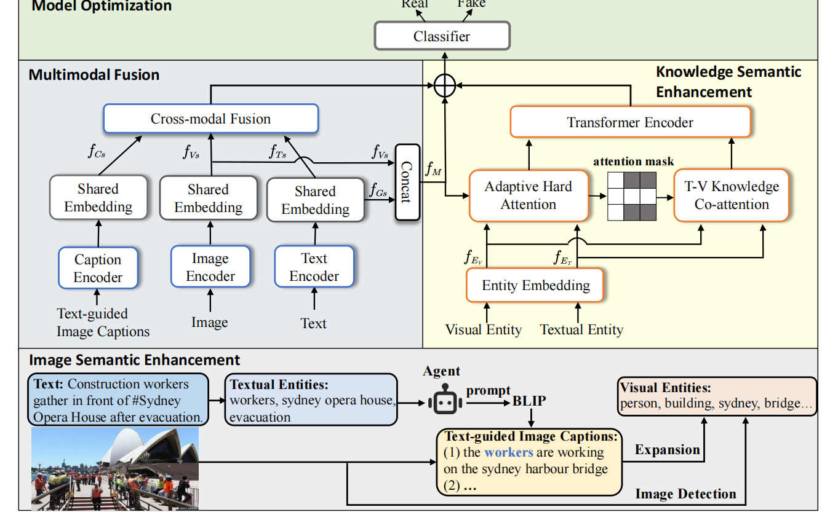
文本：BERT、Bi-LSTM 图片：BLIP 讲解人：谭玲
Chongqing University of Technology
Chongqing University of Technology
2023_MM_Hierarchical Semantic Enhancement Network for Multimodal Fake News Detection

Slide 2
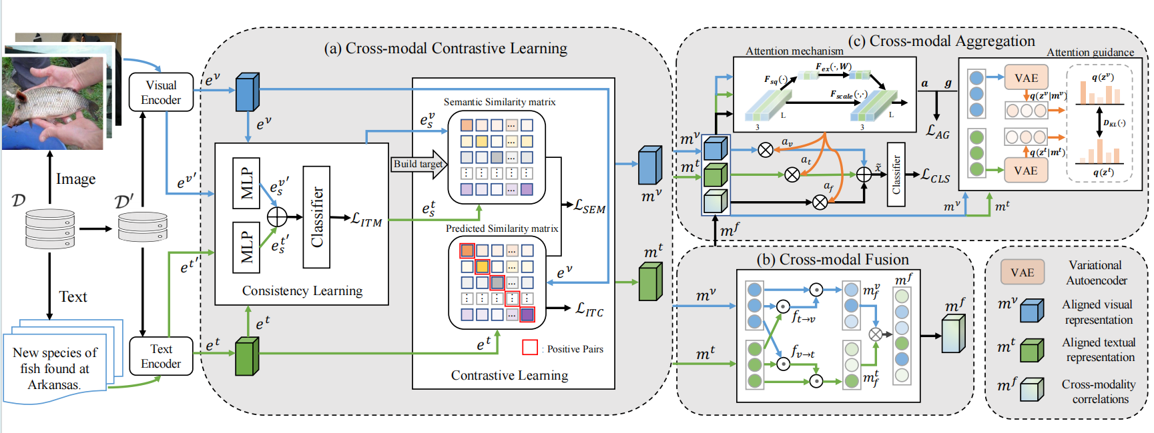
文本：BERT 图片：VGG19 讲解人：蒋书明
Chongqing University of Technology
Chongqing University of Technology
2023_MM_Cross-modal Contrastive Learning for Multimodal Fake News Detections

Slide 3
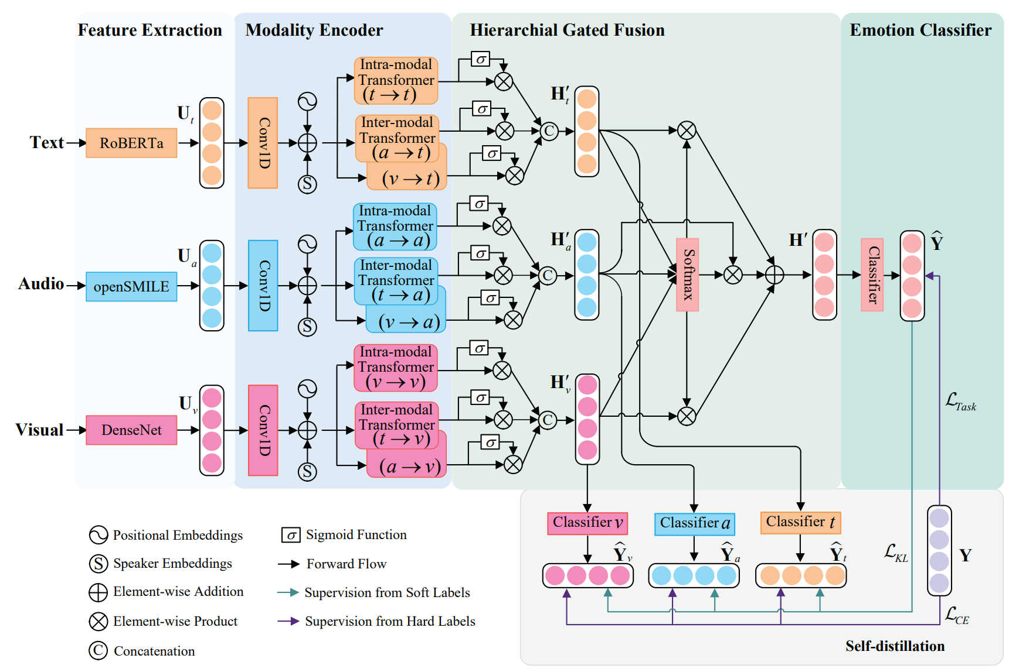
文本：RoBERTa 音频：openSMILE 视频：DenseNet 讲解人：张晋源
Chongqing University of Technology
Chongqing University of Technology
2023_IEEE_Transformer-based Self-supervised Multimodal Representation Learning for Wearable Emotion Recognition

Slide 4
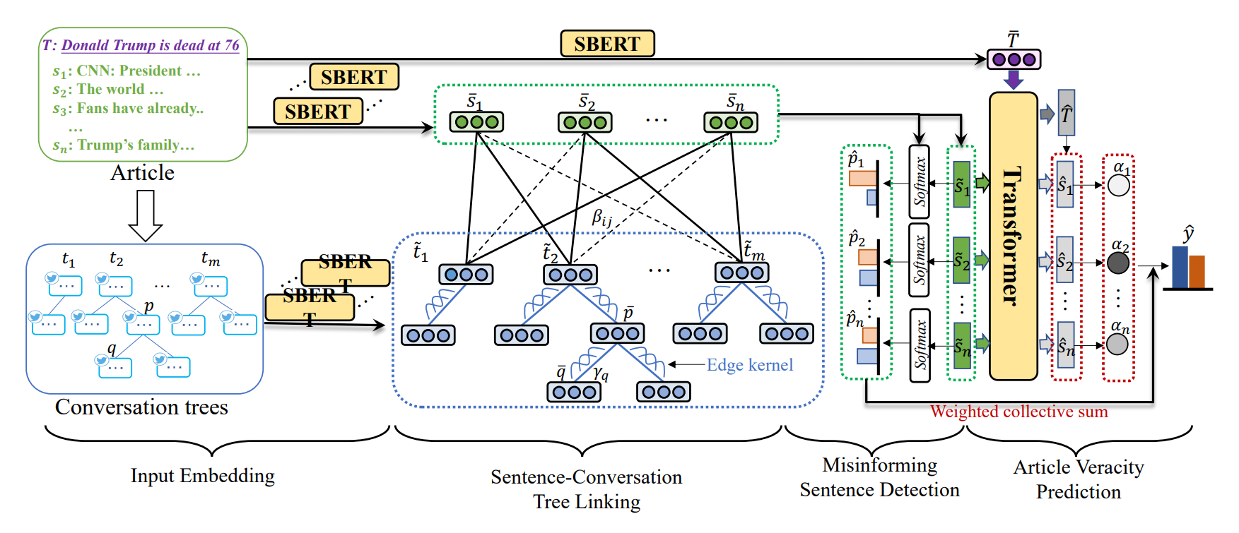
文本：SBERT 讲解人：曹均皓
Chongqing University of Technology
Chongqing University of Technology
2023_EMNLP_WSDMS Debunk Fake News via Weakly Supervised Detection of Misinforming Sentences with Contextualized Social Wisdom

Slide 5
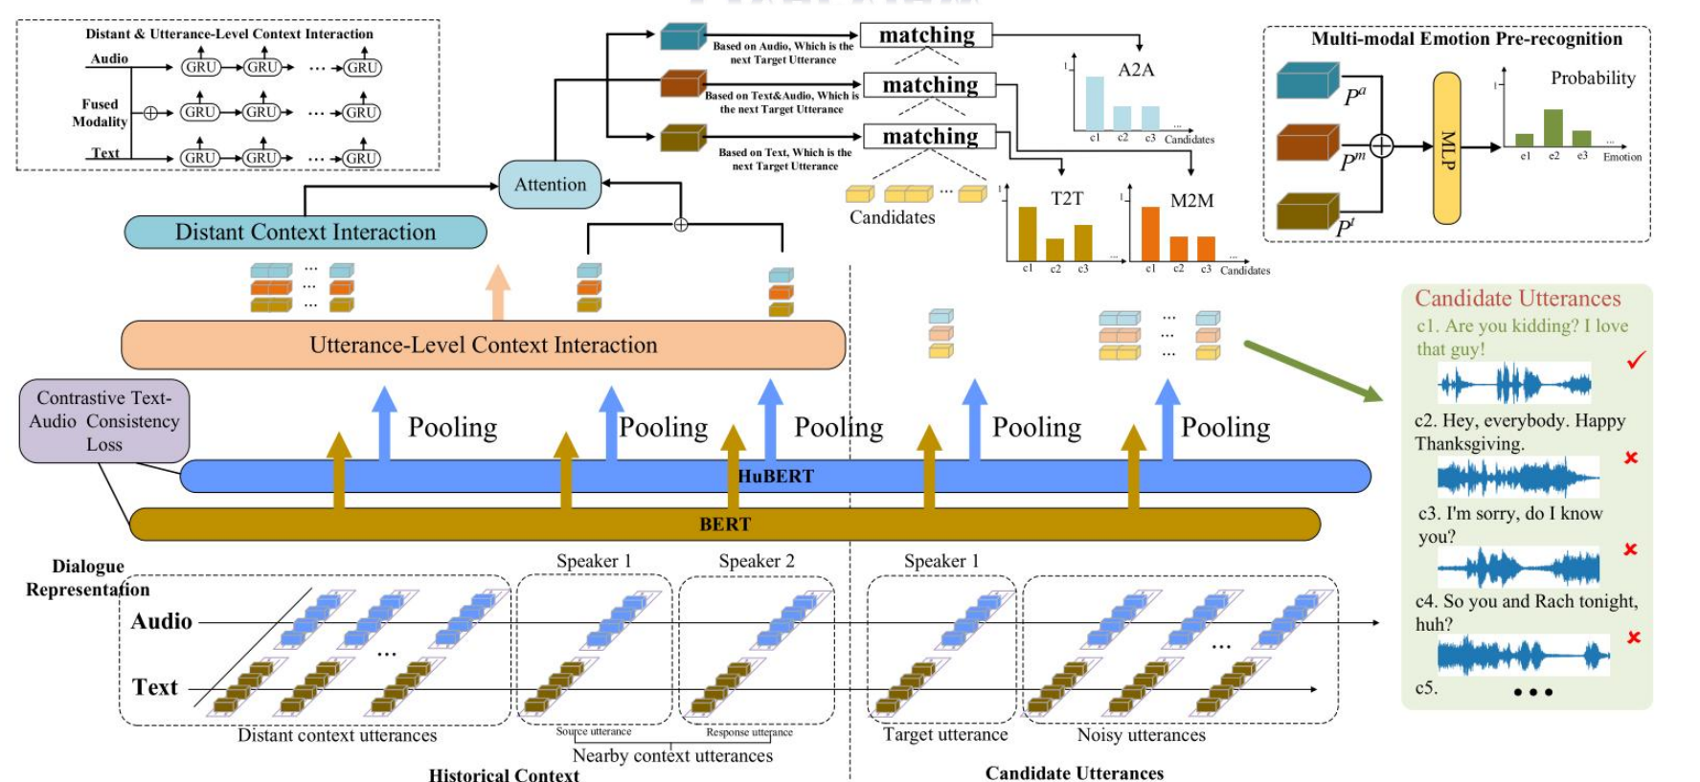
文本：BERT 音频：HuBERT 讲解人：张婷婷
Chongqing University of Technology
Chongqing University of Technology
2023_CIKM_Real-time Emotion Pre-Recognition in Conversations with Contrastive Multi-modal Dialogue Pre-training

Slide 6
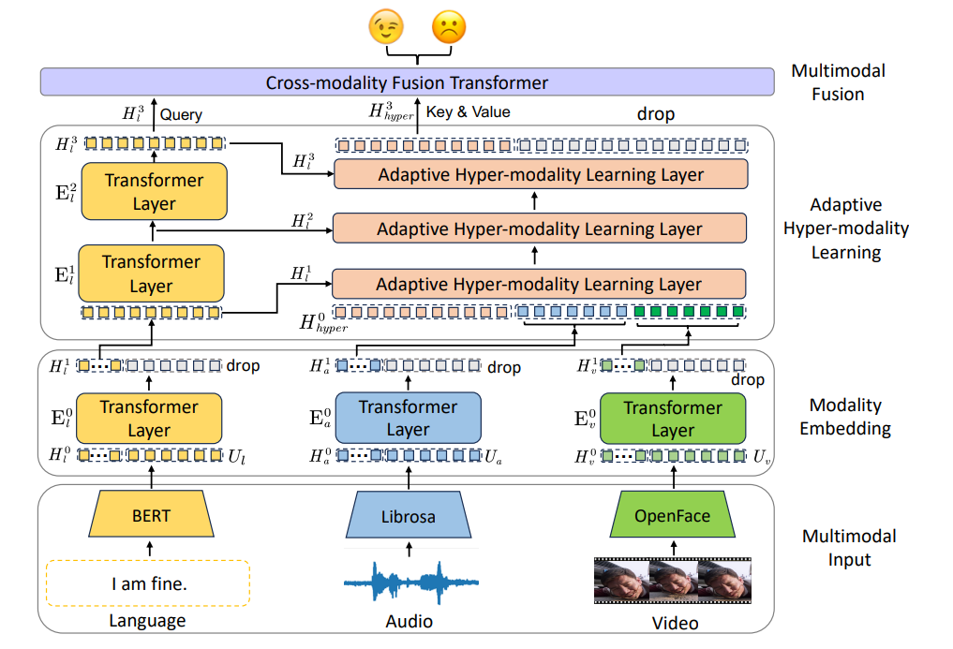
文本：BERT 音频：Librosa 视频：OpenFace 讲解人：李曜辰
Chongqing University of Technology
Chongqing University of Technology
2023_EMNLP_Learning Language-guided Adaptive Hyper-modality Representation for Multimodal Sentiment Analysis

Slide 7
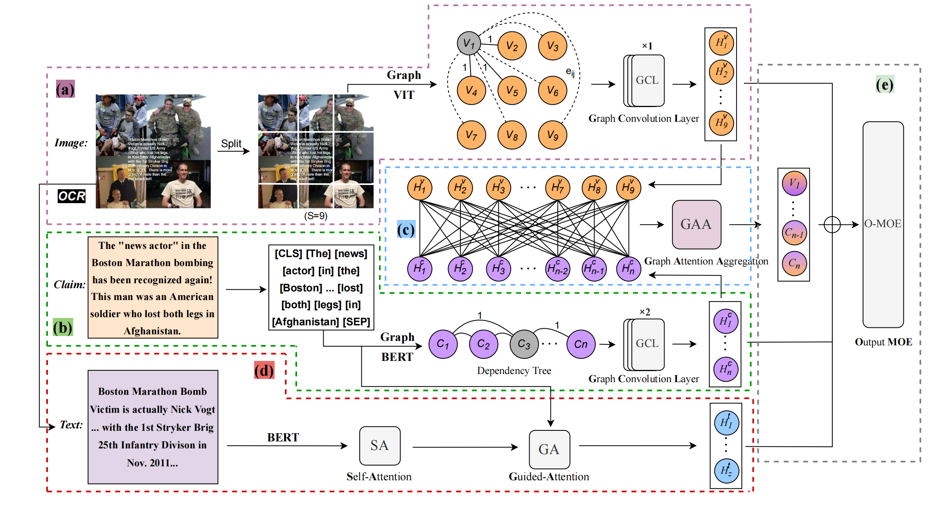
文本：BERT 图片：VIT 讲解人：谭玲
Chongqing University of Technology
Chongqing University of Technology
2023_ICMR_Graph Interactive Network with Adaptive Gradient for Multi-Modal Rumor Detection

